Slide 1
Shape capture: Visual Hull Foundations
Ahmed Elhayek
june, 4 2012

Slide 2
Motivation
Visual Hull (VH) or Shape-From-Silhouette(SFS) is a popular method of shape estimation
Many applications such as:
obstacle avoidance
human motion tracking and analysis
Advantages:
easy
provide an upper bound
Limitation:
coarse approximated with a few cameras.

Slide 3
Papers
The Visual Hull Concept for Silhouette-Based Image Understanding [TPAMI 1994]
Visual Hull Alignment and Refinement Across Time: A 3D Reconstruction Algorithm Combining Shape-From-Silhouette with Stereo [CVPR 2013]

Slide 4
Related Works
Shape-From-Silhouette (SFS) was first introduced by B. Baumgart in 1974
The idea of visual hall (VH) was first introduce by A. Laurentini in 1991:
The visual hull: A new tool for contour-based image understanding
Thereafter, different variations, representations and applications of SFS have been proposed

Slide 5
The Visual Hull Concept for Silhouette-Based Image understanding

Slide 6
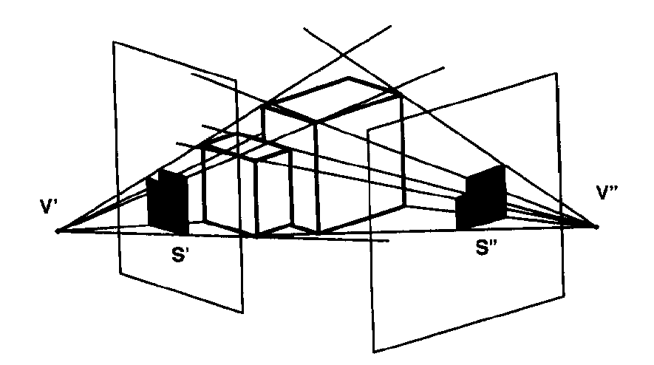
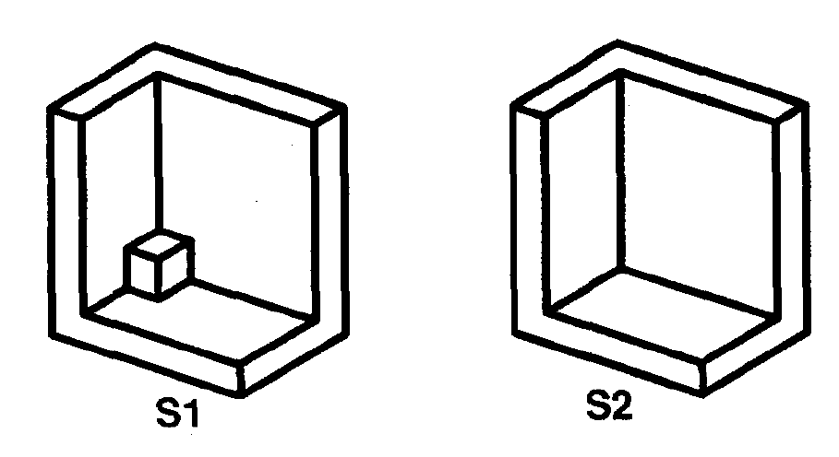
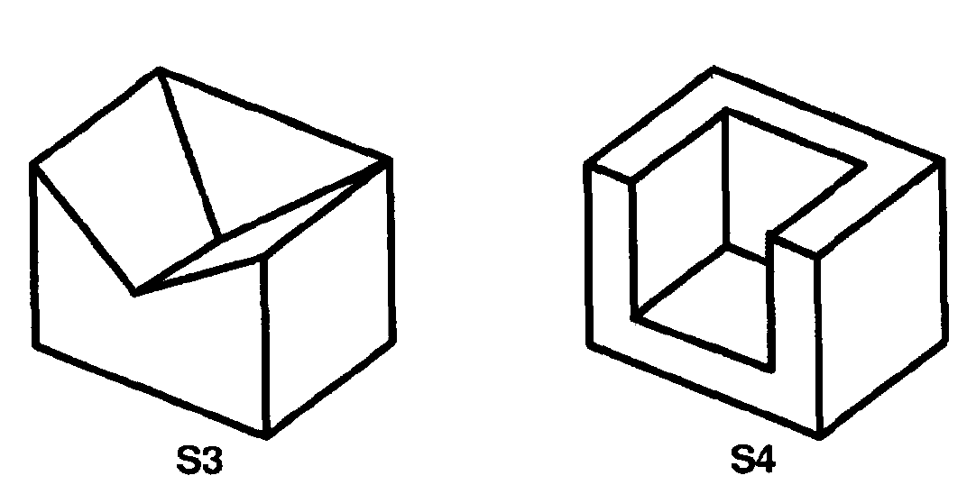
The Visual Hull Concept
Volume intersection methods can't reconstruct a nonconvex object
The Visual hall (VH) was introduced to studies the nonconvex parts of the objects
VH is the closest approximation of an object that can be obtained with the volume intersection approach

Slide 7
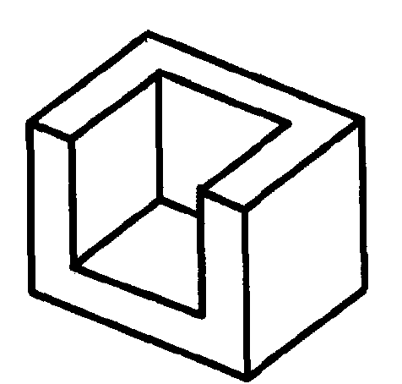
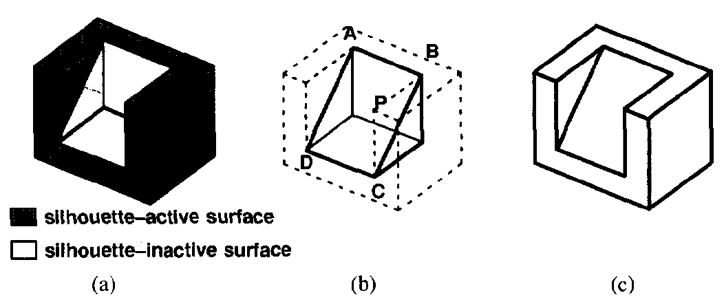
The Visual Hull Concept
VH answer the following question:
Which parts of the object affects its silhouettes?
Which part can be changed without affecting any silhouettes?
Which part can be exactly reconstructed?
What is the closest approximation of the object?

Slide 8
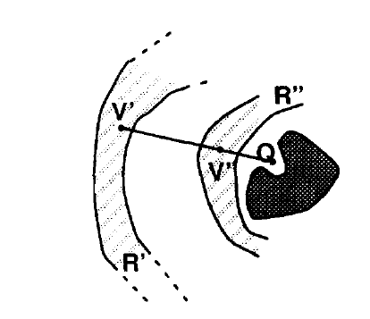
External Visual Hall
Definition:
Given: an object S relative to a viewing region R
VH(S, R) , where for each point Q VH(S, R)
the half-line starting at V and through Q contains at least a point of S.
It can be shown that:
there is a unique
VH(S, R) ≤ CH(S) (convex hull),
if R completely enclose S
S and S` can be discriminated iff
VH(S, R) ≠ VH(S`, R)
S can be exactly reconstructed by SFS iff S = VH(S, R)
Unique VH

Slide 9
VH Answers
The VH answers for the previous question:
Which parts of the object affects its silhouettes?
Which part can be exactly reconstructed?
It is the common boundary between S and VH
(silhouette-active surface of S)
Which part can be changed without affecting any silhouettes?
It is the silhouette-inactive surface of S
Which is the closest approximation?
VH(S, R)

Slide 10
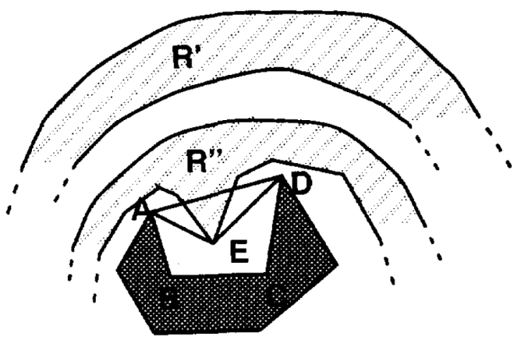
Interval Visual Hull (IVH)
The viewing region is bounded by S
Q belongs to IVH(S) iff any half-line passing through Q contains at least one point of S.
For all the Objects so far IVH = S
IVH admits interesting visual interpretation not related to silhouettes, for example:
The internal silhouette-inactive surface, cannot be observed from any viewpoint V CH(S).
Viewing regions

Slide 11
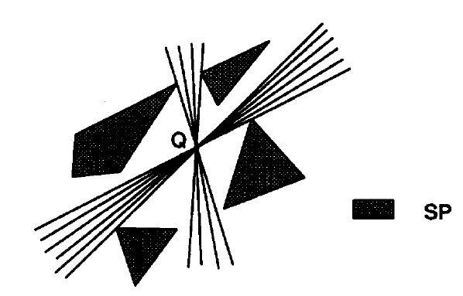
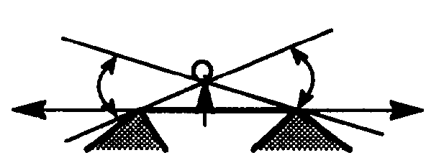
2D Visual Hull Algorithm
Works only for a set of polygons SP
Visual line: straight line belonging to Q that does not intersect SP
Visual lines of Q can be grouped into a number of families
The visual number VN(Q, SP) is the number of families
Q VH(SP) iff it’s VN(Q,SP) = 0
Active segment: boundary between points whose VN differ by one
Families of visual lines
Active segment

Slide 12
2D Visual Hull Algorithm
Algorithm Outline:
Compute all the active segments
Construct a partition of the plane produced by these segments using plane sweep algorithm
Starting from a region inside object:
traverse the partition in order of adjacent
compute the visual number of each region
Merge the regions whose VN is zero

Slide 13
2D Visual Hull Algorithm - Example

Slide 14
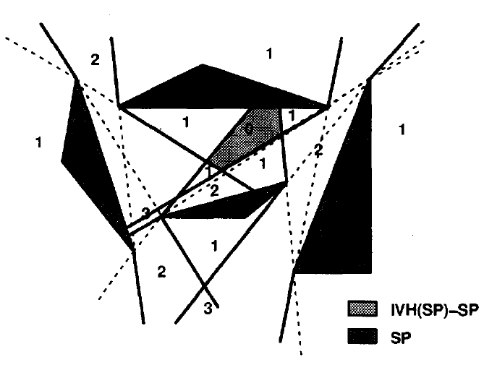
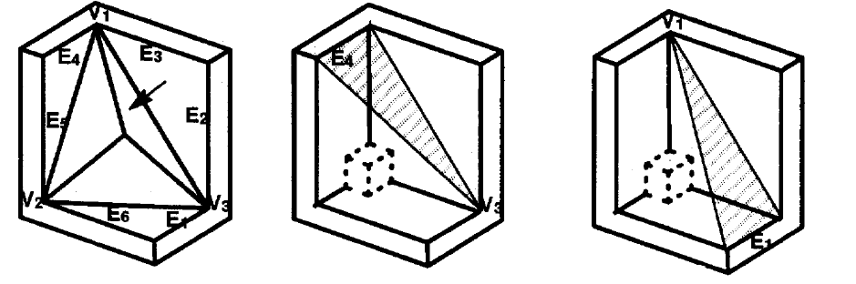
Visual Hull Algorithm Extentions
Internal 2D VH: based on visual half-lines
3D VH for polyhedra: based on active surfaces

Slide 15
Visual Hull Alignment and Refinement Across Time: A 3D Reconstruction Algorithm Combining Shape-From-Silhouette with Stereo

Slide 16
Motivation
Shape-From-Silhouette (SFS) Limitation:
coarse approximated with a few cameras.
Solution: increase the number of view by:
across space approach
across time approach by:
VH alignment: estimating the rigid motion between the VH’s formed at different time instants
VH reﬁnement: combining them to get a tighter bound on the object’s shape

Slide 17
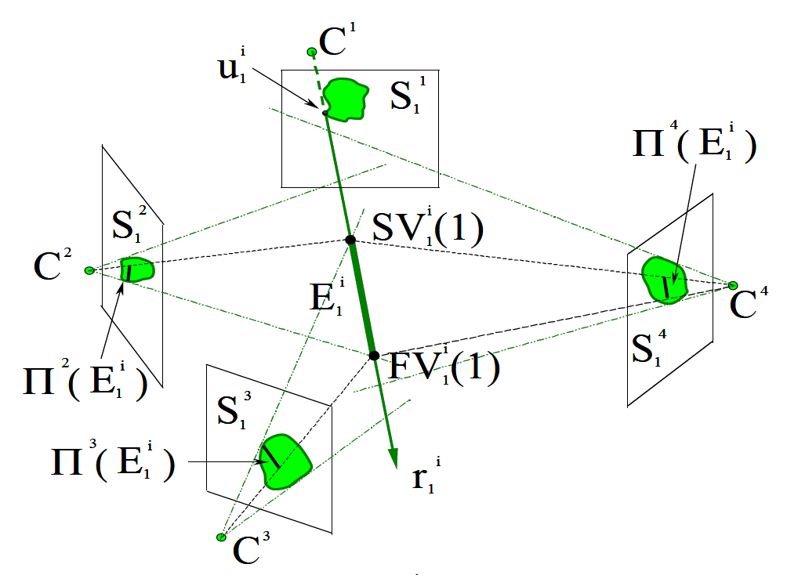
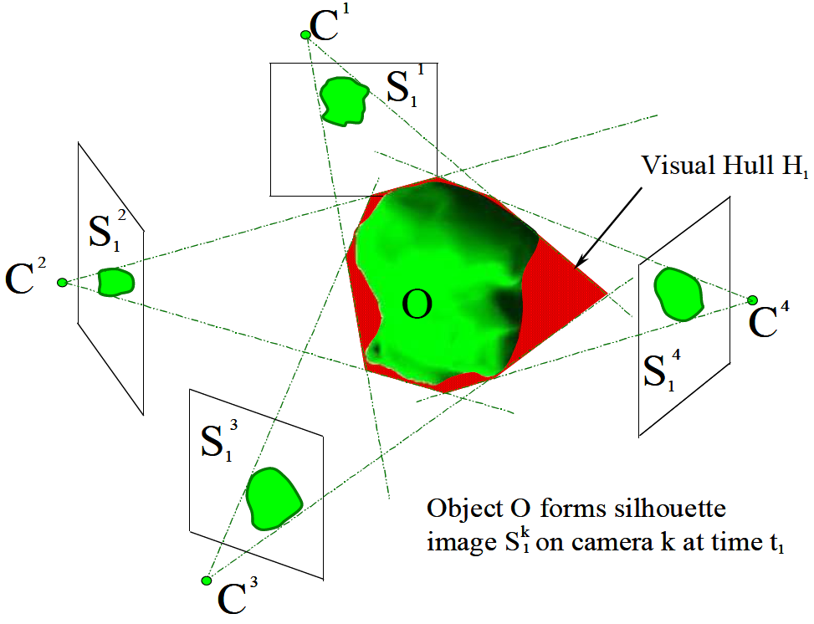
Bounding Edge VH Representation
Sampling 2D points from the silhouette boundaries
Project each 2D points into 3D space
Project the ray to other silhouette images
Re-projecting into 3D space

Slide 18
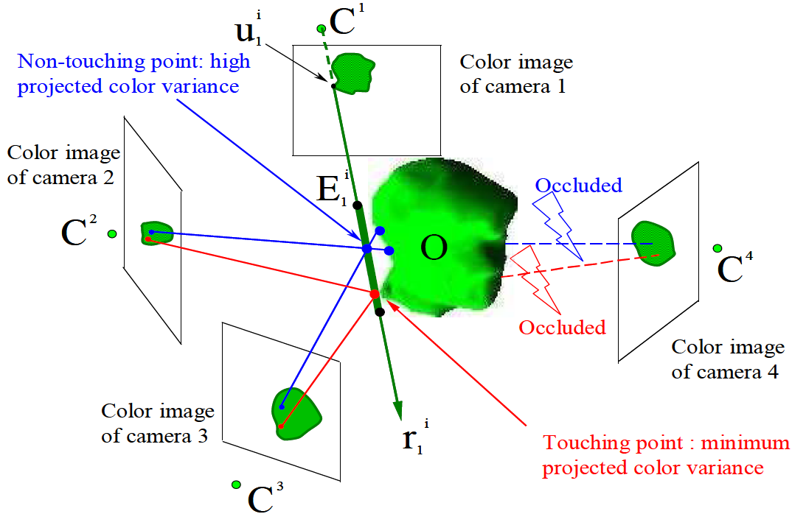
Locating 3D Colored Surface Points
Fundamental Properties of VH’s (FPVH):
Bounding edges touches the object at at least one point
FPVH + color stereo = 3D points on the surface

Slide 19
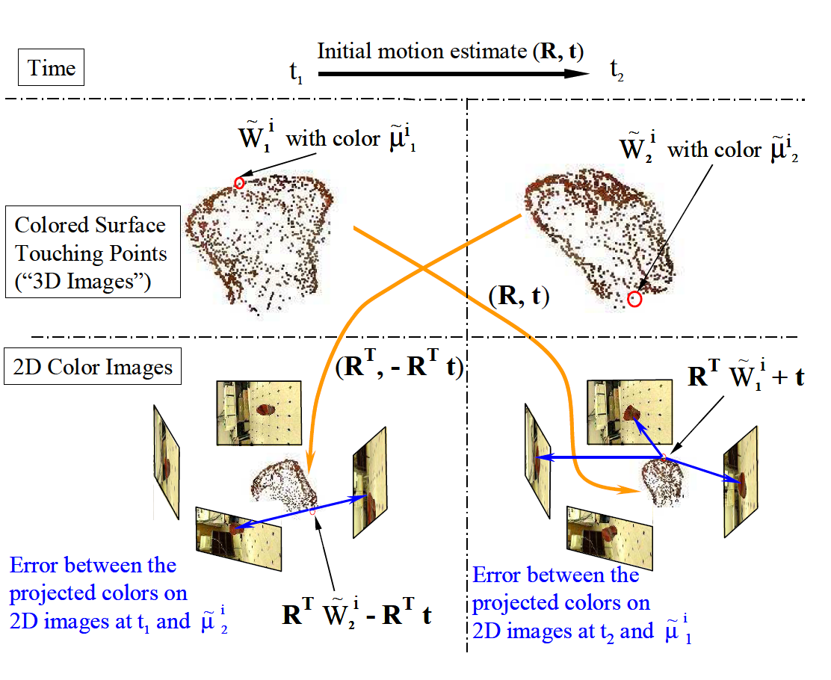
Alignment Using Colored Surface Points

Slide 20
Visual Hull Refinement
for each frame j can be estimated by minimizing:
Fixing the first frame as the reference time
Combine any silhouette image with by considering:
additional cameras placed at positions and orientations transformed by
as “new” silhouette images capture with this camera at the same time of
All of the silhouette images are used in refinement

Slide 21
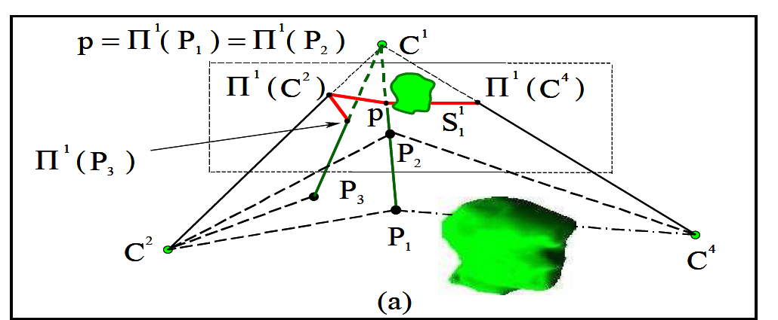
Determining Visibility

Slide 22
Results

Slide 23
Discussion

