Slide 1
Pose estimation: Foundations
Thomas Helten
Saarland University and MPI Informatik
CVfCG Seminar
June 11th 2013
Notes:
I am going to present a method that performs full-body pose estimation from just one camera in real-time.

Slide 2
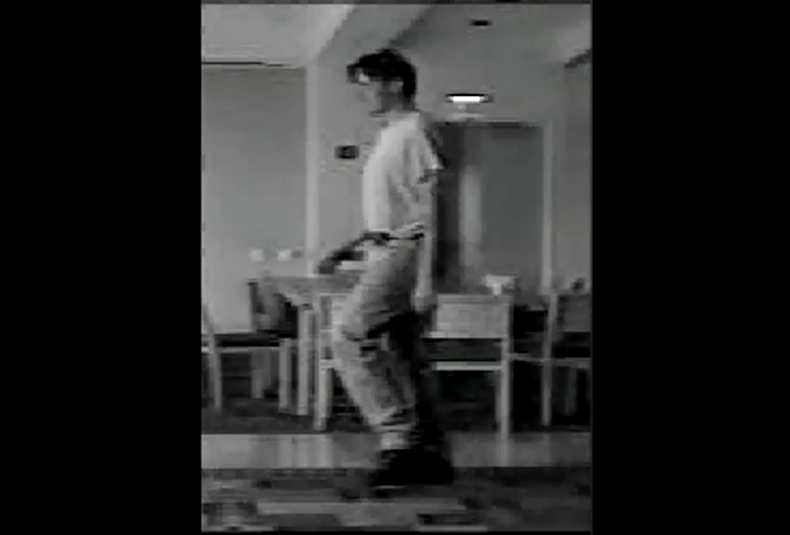
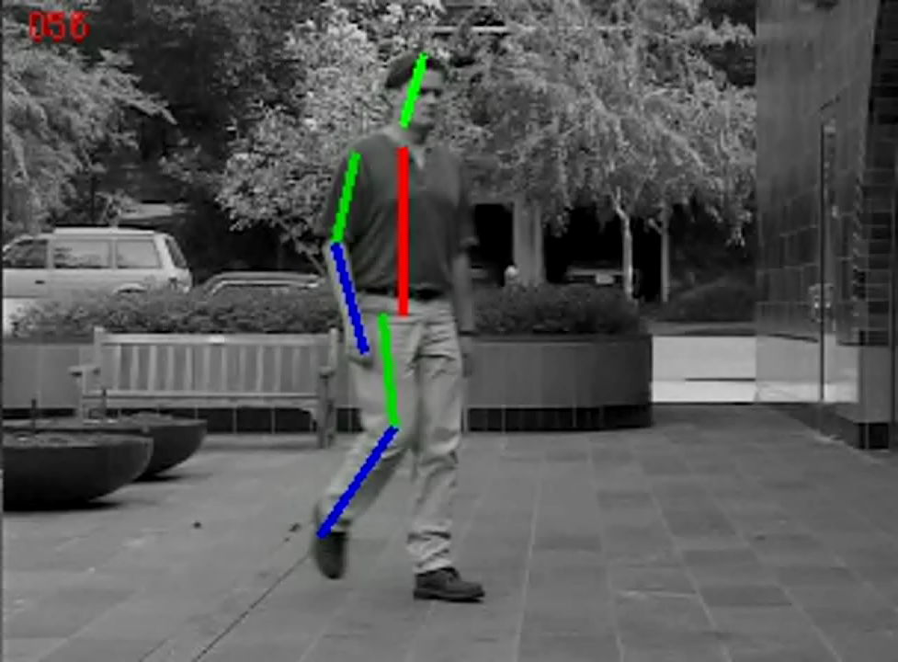
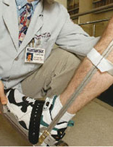
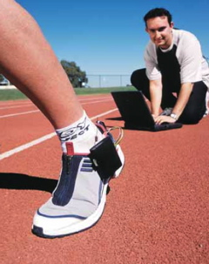
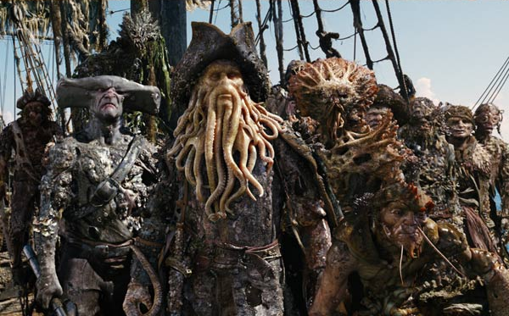
Motivation
Notes:
Capturing human motions is important with many applications to….

Slide 3
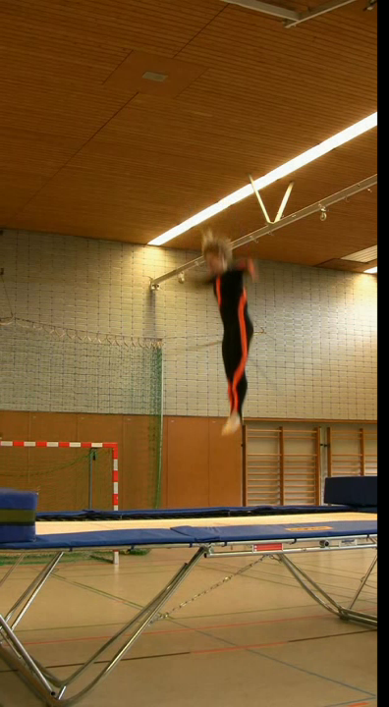
Challenges
Motions can be fast and non-linearly
3D to 2D projection is ambiguous
Large occlusions might occur
Similar appearance of different limb
Notes:
Capturing motions can be hard…

Slide 4
From Tracking to Pose Estimation
t
t+1
Standard Techniques:
Template Matching
Edges / Shape / Color
Background Subtraction
Optical Flow
New Challenges:
Complex Variation
Self Occlusion
Noise (Folds, Low Contrast)

Slide 5
Optical Flow
local
ambiguities

Slide 6
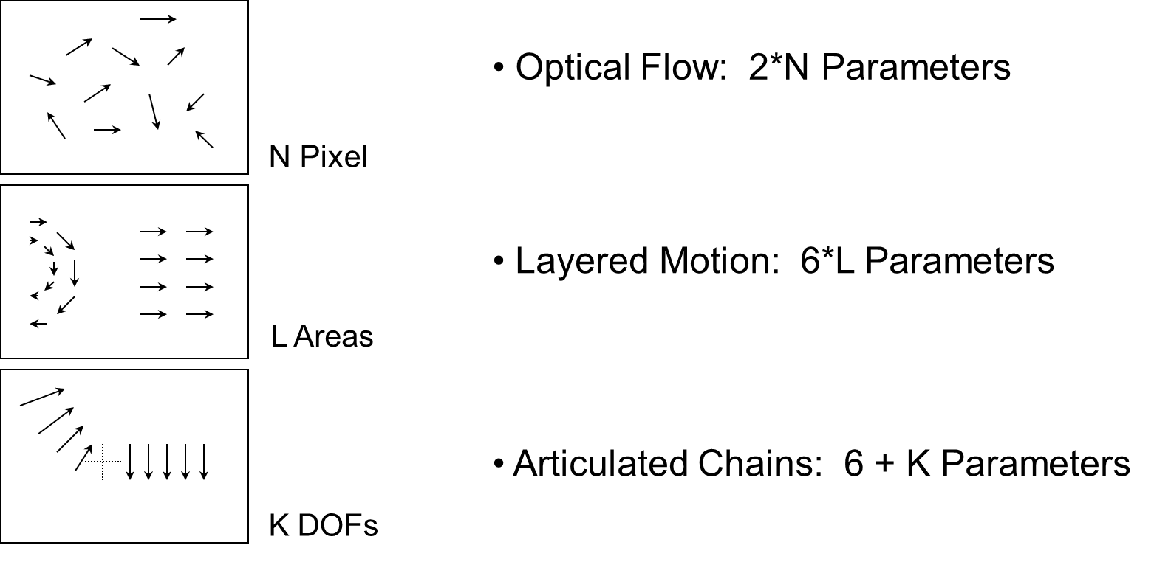
Parameterization of Motion

Slide 7

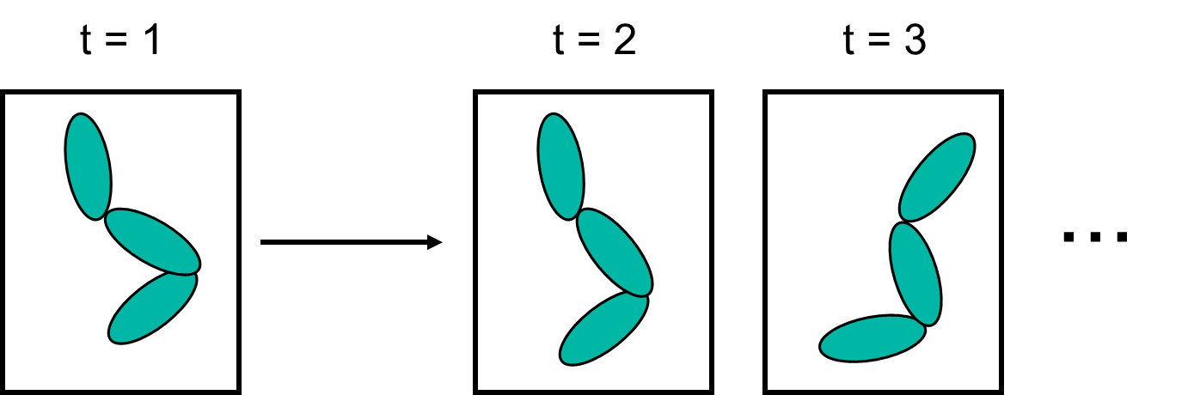
Articulated Chain
C. Bregler, J. Malik,
Tracking People with Twists and Exponential Maps,
In Proc. CVPR, 1998

Slide 8
Twist Motion
^
r1 r2 r3 dx
r4 r5 r6 dy
r7 r8 r9 dz
0 0 0 1
= e
ξ
q
= G
q
G =
t+1
t
ξ
0 −ω3 ω2 υ1
ω3 0 −ω1 υ2
−ω2 ω1 0 υ3
0 0 0 0
^
ξ =
R. M. Murray, Z. Li, S. S. Sastry
A Mathematical Introduction to Robotic Manipulation,
CRC Press, 1994
Notes:
Proof: any arbitrary motion can be coded in that form
and converted back to 4x4 homogenious matrix: exponetial map

Slide 9
Articulated Chain
^
^
^
ξ
ξ
ξ
G = e e e
α
α
0
1
1
2
2
ξ
α
1
1
ξ
α
G(ξ ,α , α )
ξ
2
2
0
1
2
0
Notes:
Another very nice properity of this formulation: very easy to code
kinematic chains: (orginal idea)
For example: a joint axis can be coded by a twist: and fixing that 6D
vector I can describe the rigid motion by multipluiong the rotation
angle to the twist and put it into the exponential map
so this leads to the next chapter in Murray Lee and Sastry:
Product of E
tip of kinematic chain:
pose change: embedded in that rotation around 1 DOF (just product)

Slide 10
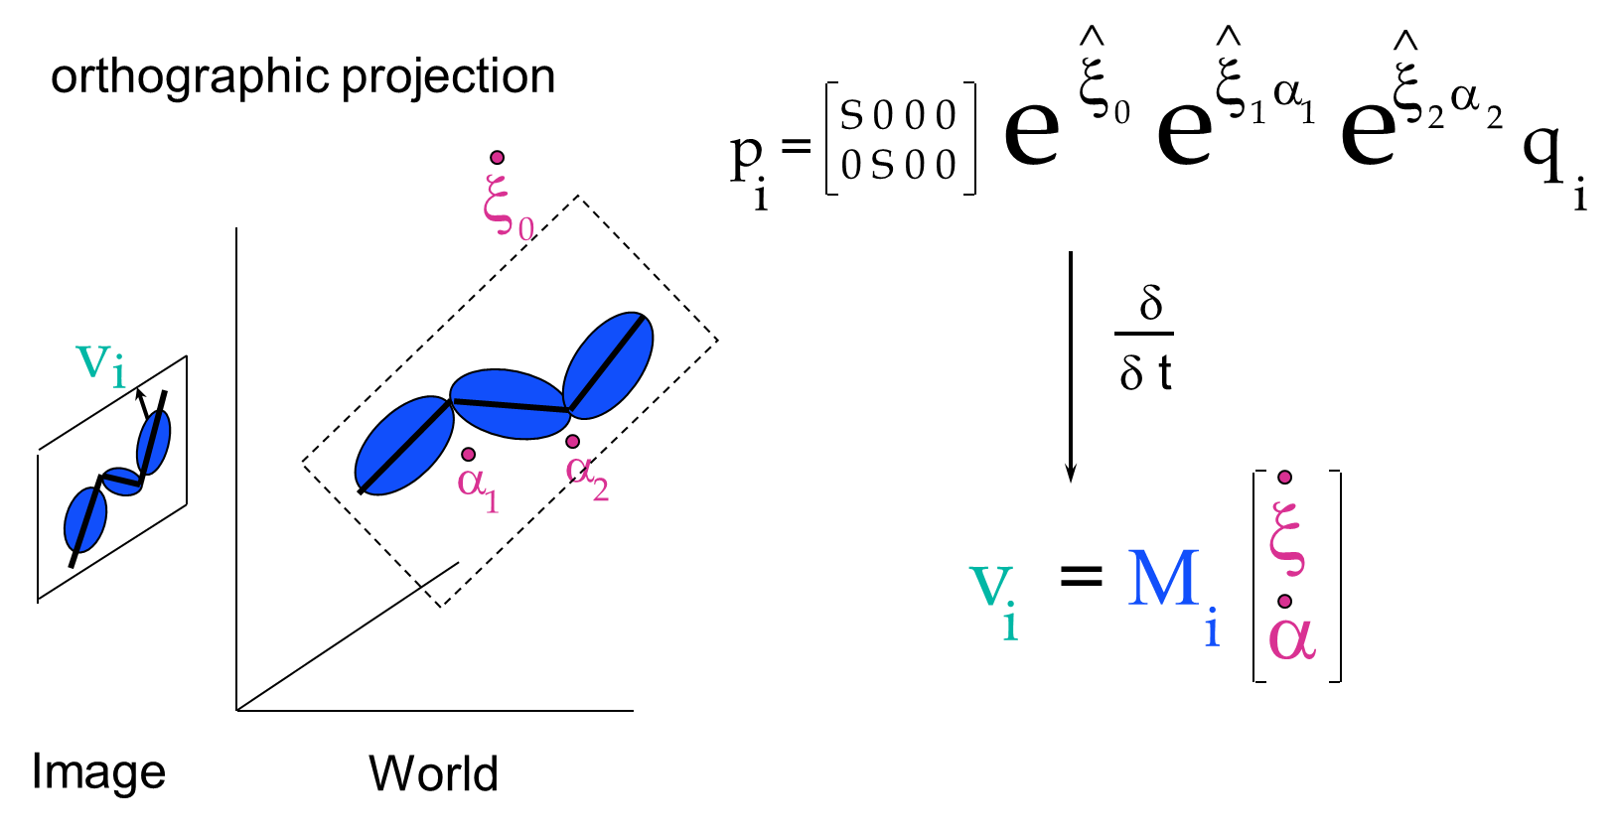
Image Velocities
Notes:
NOW: the very nice property of this formulation is:
if you compute the derivatives of this product of exponential
(I skip the math here…)
the projected image velocity of a point is linearly related to the pose
change (a 6d twist) and angular velocities of the kinematic chain
That’s what we want:

Slide 11
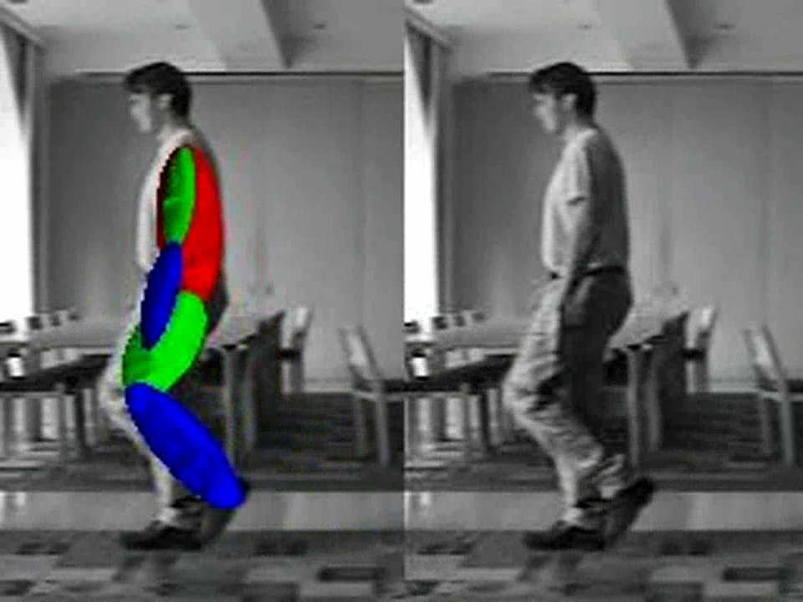
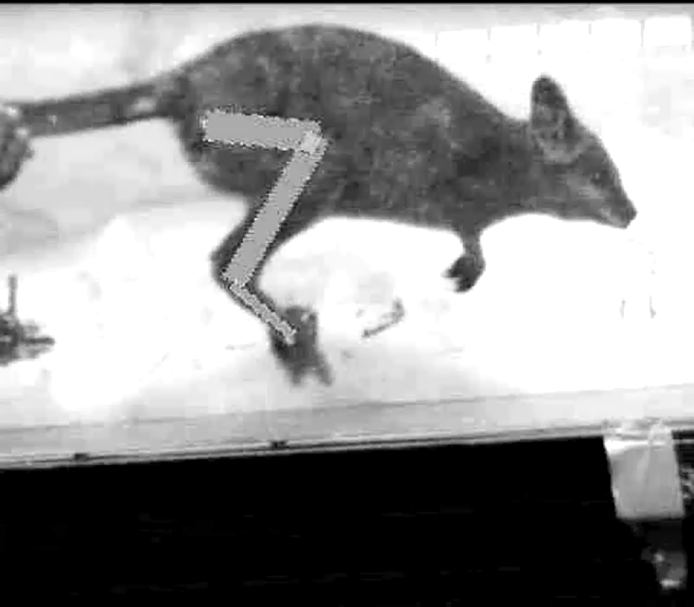
Results

Slide 12
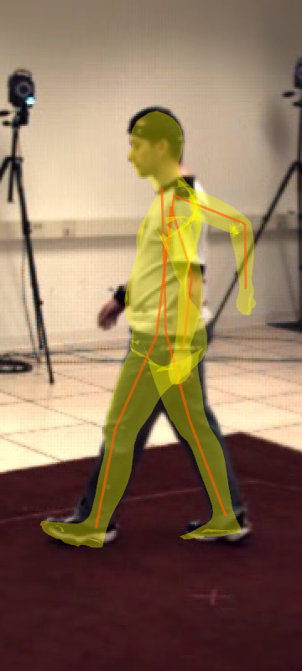
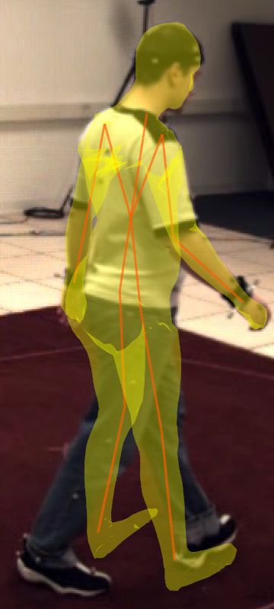
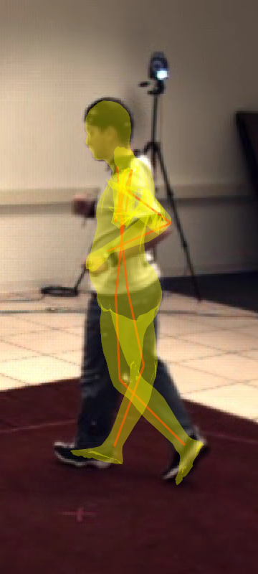
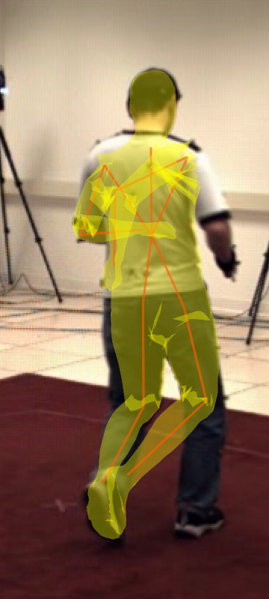
Limitations
Needs manual initialization
Can loose track
Prone to occlusions and ambiguities
=> Tracking errors

Slide 13
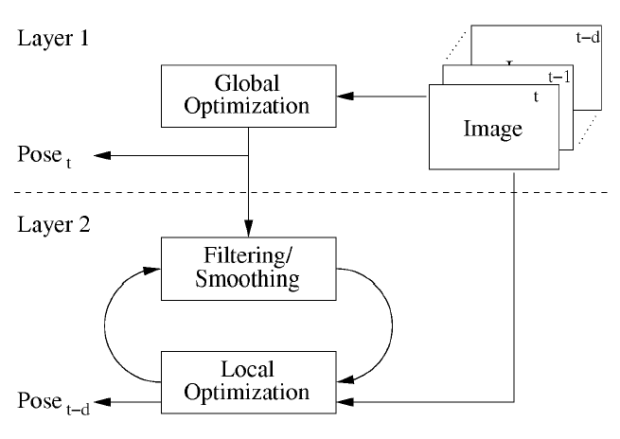
Multi-Layered Tracking
J. Gall, B. Rosenhahn, T. Brox, H.-P. Seidel,
Optimization and Filtering for Human Motion Capture,
In IJVC, 2008

Slide 14
Local Optimization
V
Energy
Parameter space
X
e.g. x = (ξ₀, α₁, α₂,... ) ∈ X

Slide 15
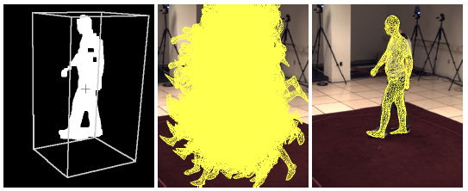
Global Optimization
V
Energy
Parameter space
X
η
Weighting
Parameter space
X

Slide 16
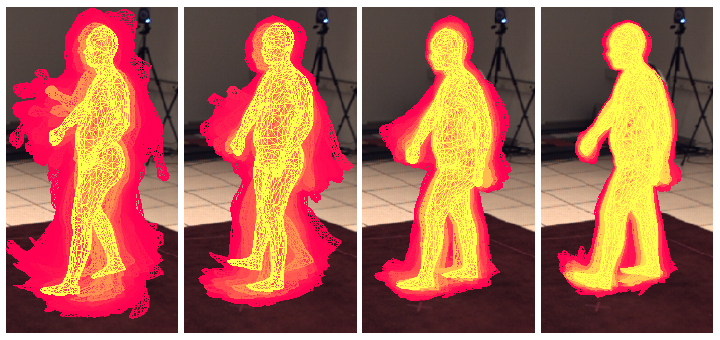
Global Optimization
V
Energy
Parameter space
X
η
Weighting
Parameter space
X

Slide 17
Global Optimization
V
Energy
Parameter space
X
η
Weighting
Parameter space
X

Slide 18
Global Optimization
V
Energy
Parameter space
X
η
Weighting
Parameter space
X

Slide 19
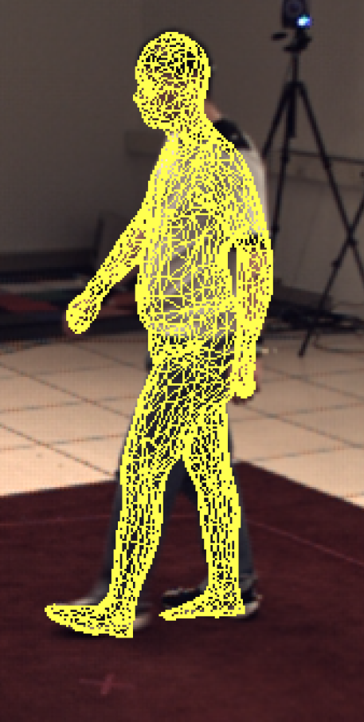
Global Optimization
V
Energy
Parameter space
X
η
Weighting
Parameter space
X

Slide 20
Multi-Layered Tracking

Slide 21
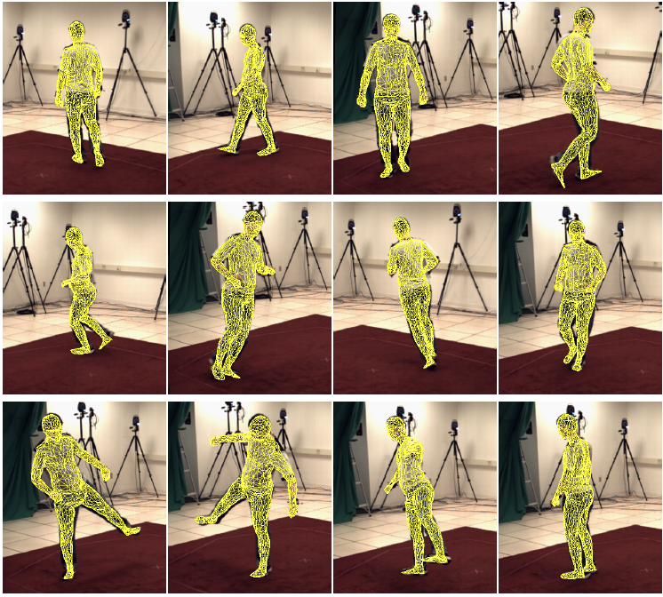
Results

