Slide 1
Illumination: Shape and Reflectance
Chenglei Wu
Graphics, Vision and Video Group

Slide 2
Agenda
Static Reconstruction
Shape from Varying Illumination and Viewpoint, ICCV 2007
Dynamic Reconstruction
Shading-based Dynamic Shape Refinement from Multi-view Video under General Illumination, ICCV 2011

Slide 3
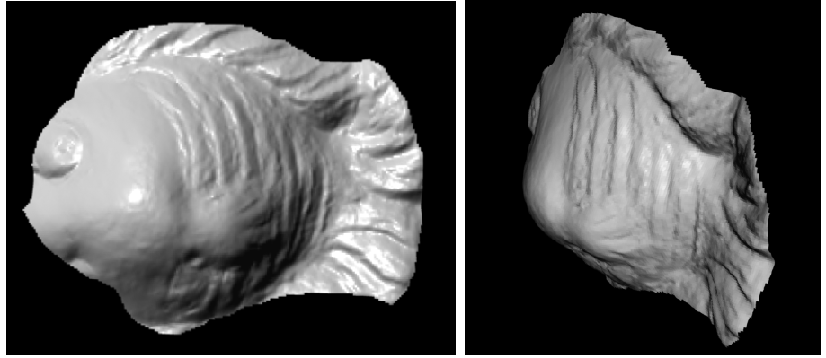
Shape from Varying Illumination and Viewpoint
Goal: given views of an object rotating in front of a light and a camera, where the lighting and object rotation is unknown, this paper recovers the 3D geometry of the object.
Notice: if assuming the object is static, then the camera and the light are rotating around the objects.

Slide 4
Pipeline
Tomasi-Kanade Factorization to get projection matrices for each image
Compute dense depth map by minimizing the multi-view photometric constraint using graph cuts
Compute normal field by photometric stereo
Recover the final surface using the dense depth map and normal field.

Slide 5
Depth estimation by photometric stereo constraint
Rank-3 Approximation for pixel neighborhood:
$I=\left[i_{0},i_{1},⋯,i_{n}\right]$
$\left[U S V\right]=svd(I)$, if depth is correct, the rank of $I$ should be 3.
photometric stereo constraint (rank 3 constraint):
$$c={\left\|I−I^{′}\right\|}^{2}$$
$$I^{′}=U^{′}S^{′}V^{′},U^{′}=U\left(:,1:3\right),V^{′}=V\left(1:3,:\right),S^{′}=S(1:3,1:3)$$

Slide 6
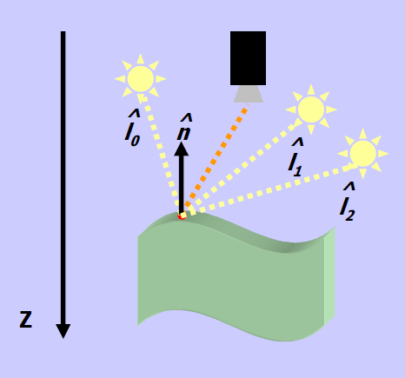
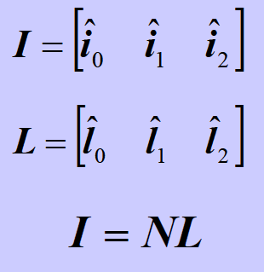
Normal recovery and geometry refinement
$I=NAA^{−1}L$
Solving the ambiguity matrix A by registering to the normal to that from the initial depth map.
With normal map recovered, which contains the high frequency of the geometry, the initial geometry is further refined by the normal constraint.
Photometric stereo

Slide 7
Results

Slide 8
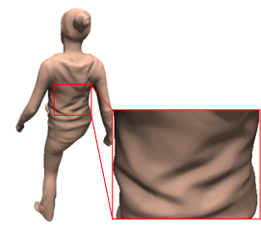
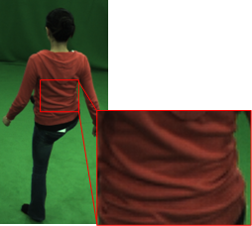
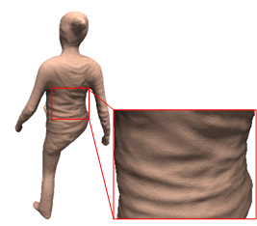
Shading-based Dynamic Shape Refinement from Multi-view Video under General Illumination
Target: High-quality 3D details for dynamic shapes without any controlled illumination
Embossed static detail from initial pose
Previous methods
Dynamic shape details from shading cues
Our method
Multi-view Video

Slide 9
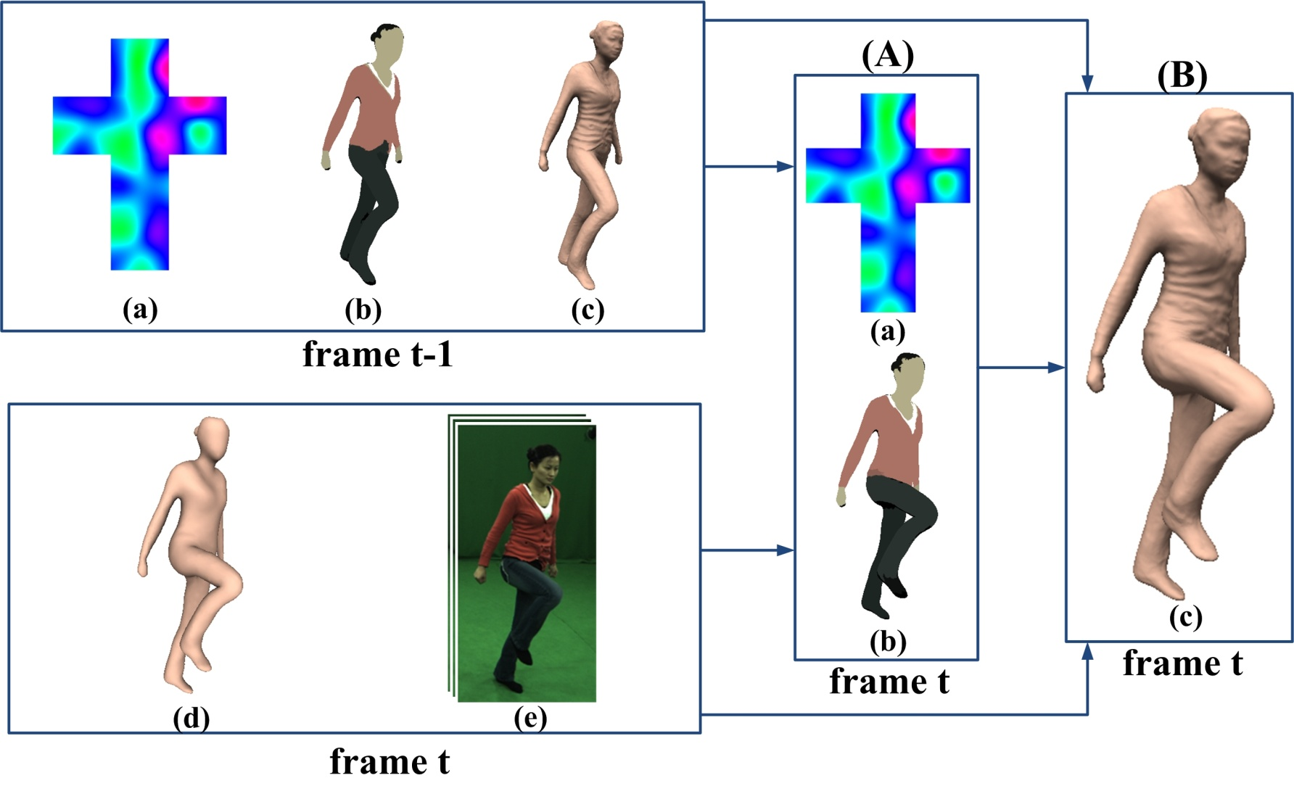
Workflow
(a)estimated lighting, (b)albedo map, (c)detailed surface geometry, (d)coarse tracked model, (e)multi-view images

Slide 10
Lighting and Albedo Estimation
Assuming k different albedo segments, the albedo values and the lighting coefficients in the Spherical Harmonic basis are simultaneously estimated by finding a MAP solution:
shading error for the current frame
priors for lighting and albedos from previous frame
represent images, lighting coefficients, albedos for the current frame.

Slide 11
Shading-based Shape Refinement
Based on the estimated lighting and albedos, the coarse shape at the current frame is refined by solving a MAP problem:
likelihood: shading error
prior: similarity to shape prediction from the previous frame
represent images, geometry for the current frame and the previous frame.

Slide 12
Results

Slide 13
Thanks for your attention!

